Slide 1




Chatbot Development with Rasa
Omkar Rane
Trainee Software Engineer
Marsh McLennan Global Service India Pvt ltd (Mercer)

Slide 2
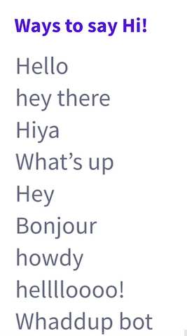

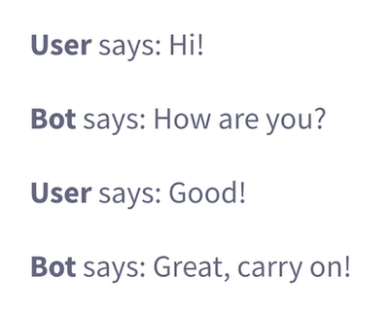

Slide 3
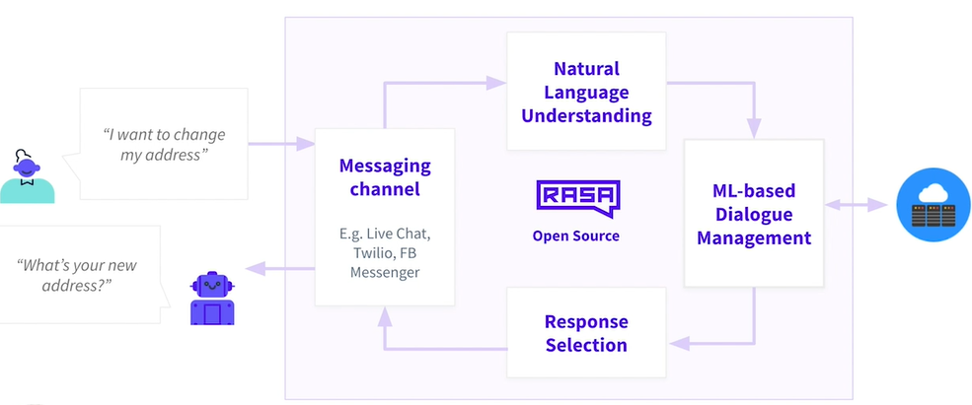
Overview of chatbot
Rasa

Slide 4
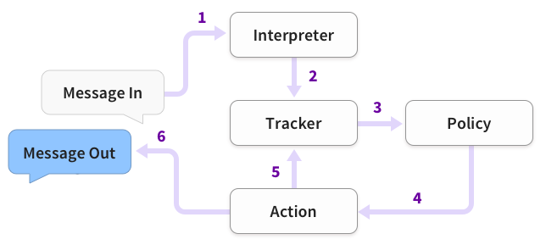
Rasa Architecture
The message is received and passed to an Interpreter, which converts it into a dictionary including the original text,
the intent, and any entities that were found. This part is handled by NLU.
The message is passed from the Interpreter to the Tracker.
The Tracker is the object which keeps track of conversation state.
The current state of the tracker is sent to each policy.
Each policy chooses which action to take next.
The chosen action is logged by the tracker.
A response is sent to the user. Ref: https://rasa.com/docs/rasa/architecture/
https://rasa.com/docs/rasa-x/api/architecture/

Slide 5
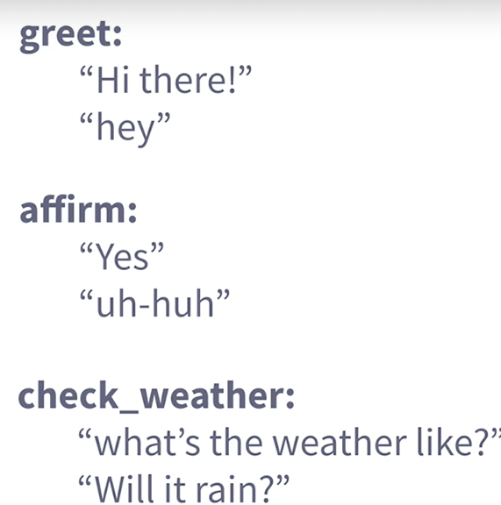
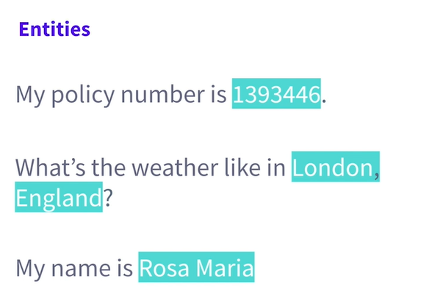
Intent & Entity

Slide 6
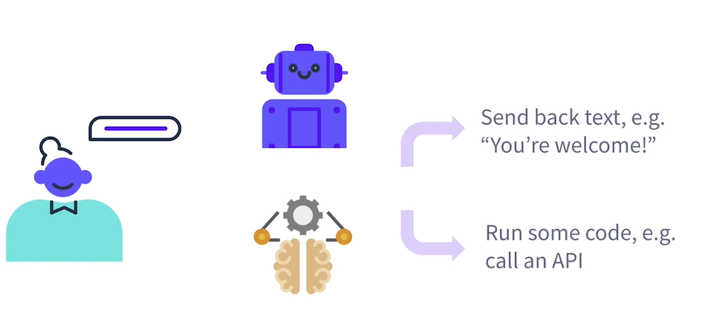

Slide 7
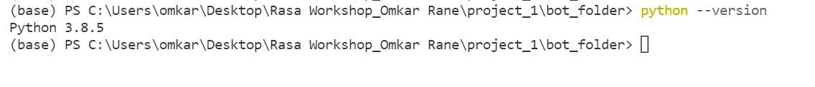
Setting Up Development Environment
Check your python version.
As requires Python 3.6, 3.7 or 3.8
python3 -m venv <name_of_virtualenv>
or
python -m venv <name_of_virtualenv>
Change directory path to:
cd <name_of_virtualenv>\Scripts
<name_of_virtualenv>\Scripts\Activate.bat
* Note: You can use conda (Anaconda) environment or python virtual environment or other. As per your project requirement.

Slide 8
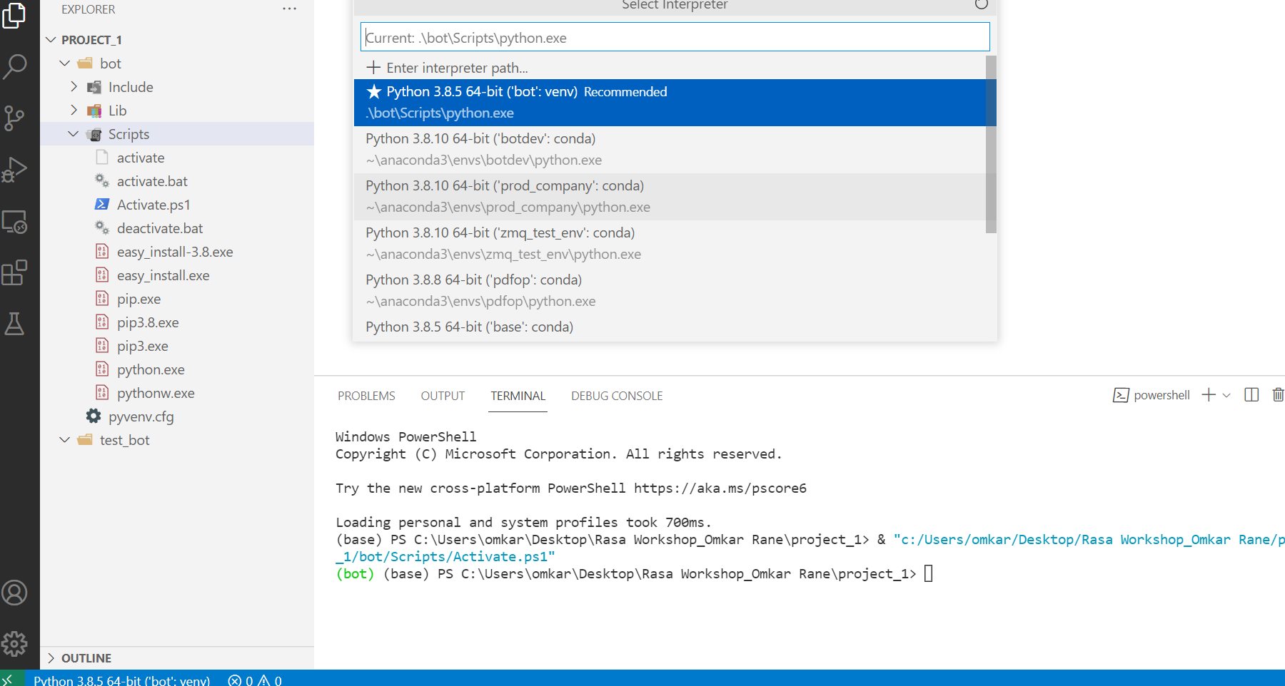
Change directory path to script folder and run ‘activate.bat’ command
Or press ‘ctrl+shift+p’ from your keyboard to select interpreter path in VS-Code environment. ‘
‘.\< name_of_virtualenv>\Scripts\python.exe ‘ then re-open new terminal from terminal menu

Slide 9
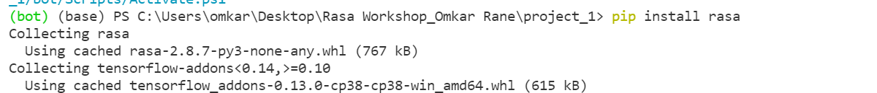
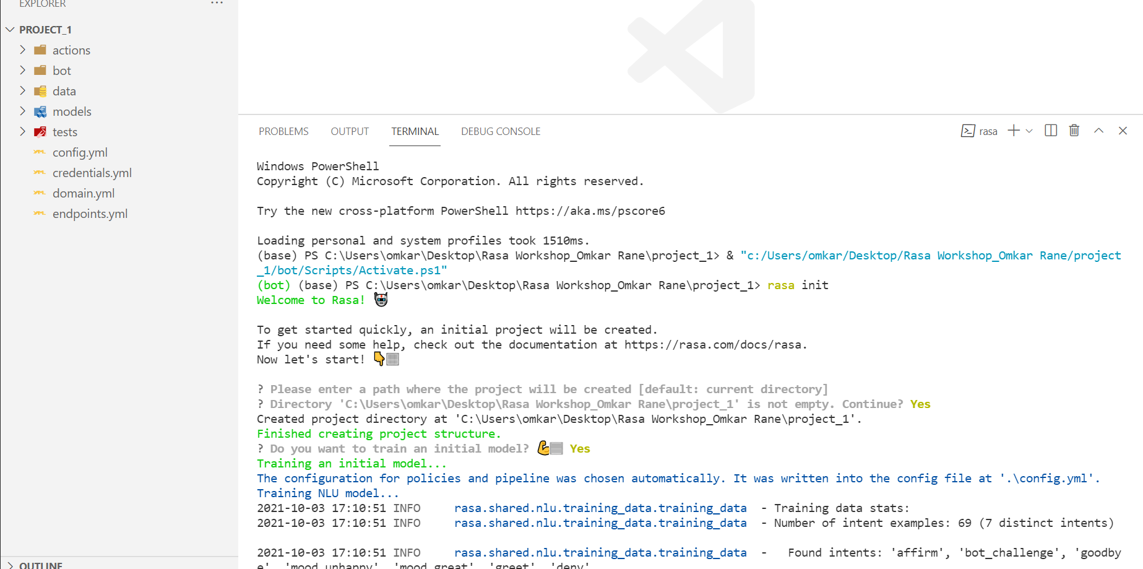
Rasa Installation in Development Environment
Step 1) pip install rasa
Step 2) Creating basic rasa file structure and training initial model by running ‘ rasa init’ command in terminal.

Slide 10
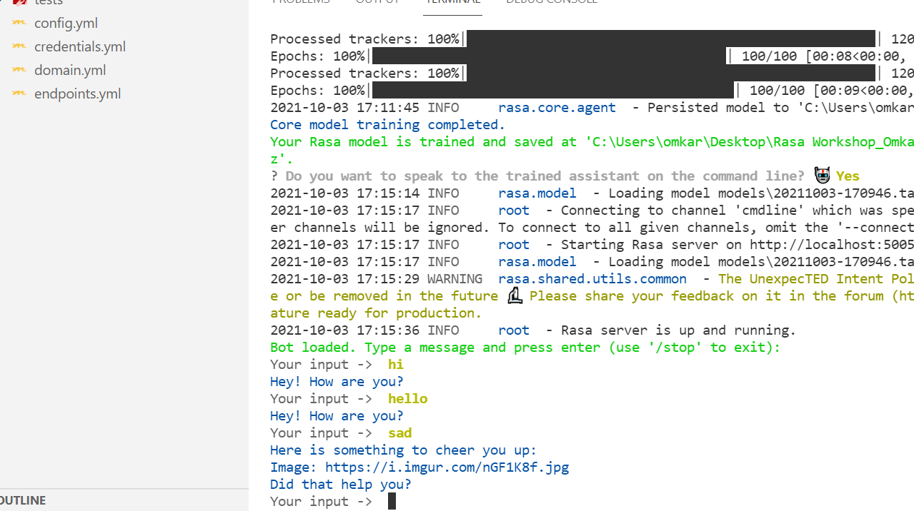
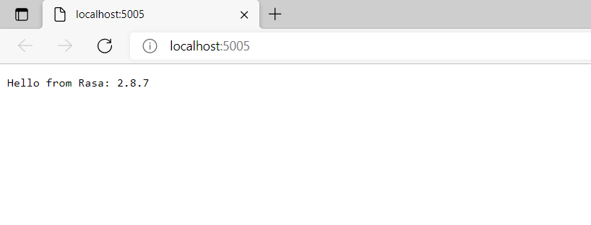
Testing pre-trained model

Slide 11
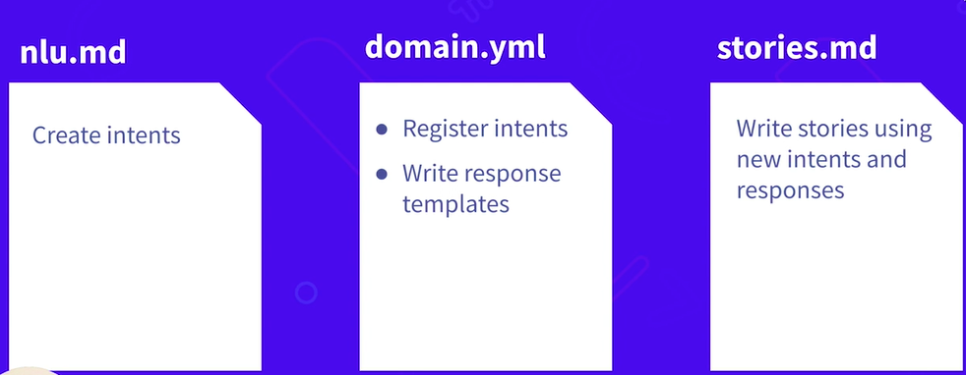
Procedure

Slide 12
Intent & Entity
nlu.md / nlu.yml
Add training data for new intent and entities.
Story(Dialog flow management)
stories.yml/stories.md
Add stories to show assistant activate and deactivate the form.
Actual coded output / response
(for all intent,entity,action and response)
Create slots
Register new intent, entities, actions & slot
Add response/action template
Register form name
domain.yml / domain.md
Custom reply
Action.py
Write code to control form behavior.
Set Slot or Get slot
Fetch values from api

Slide 13
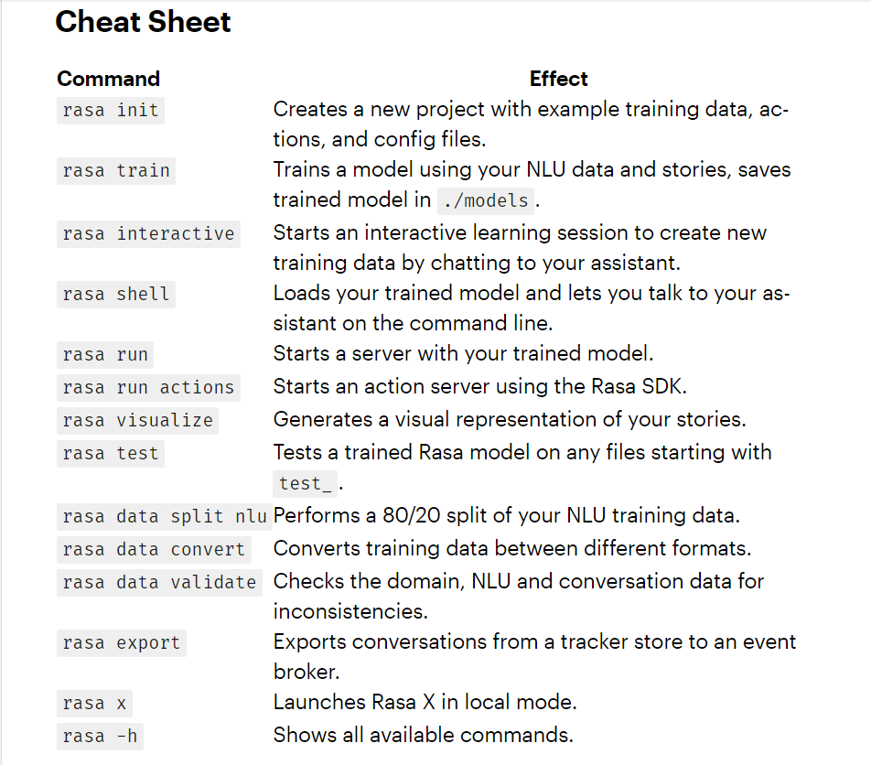
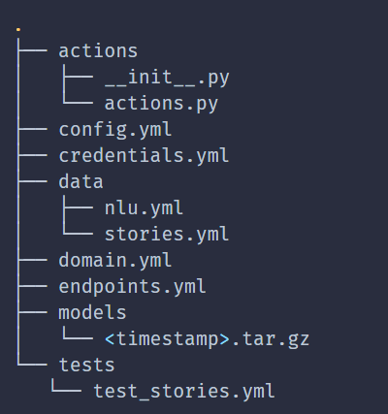

Slide 14
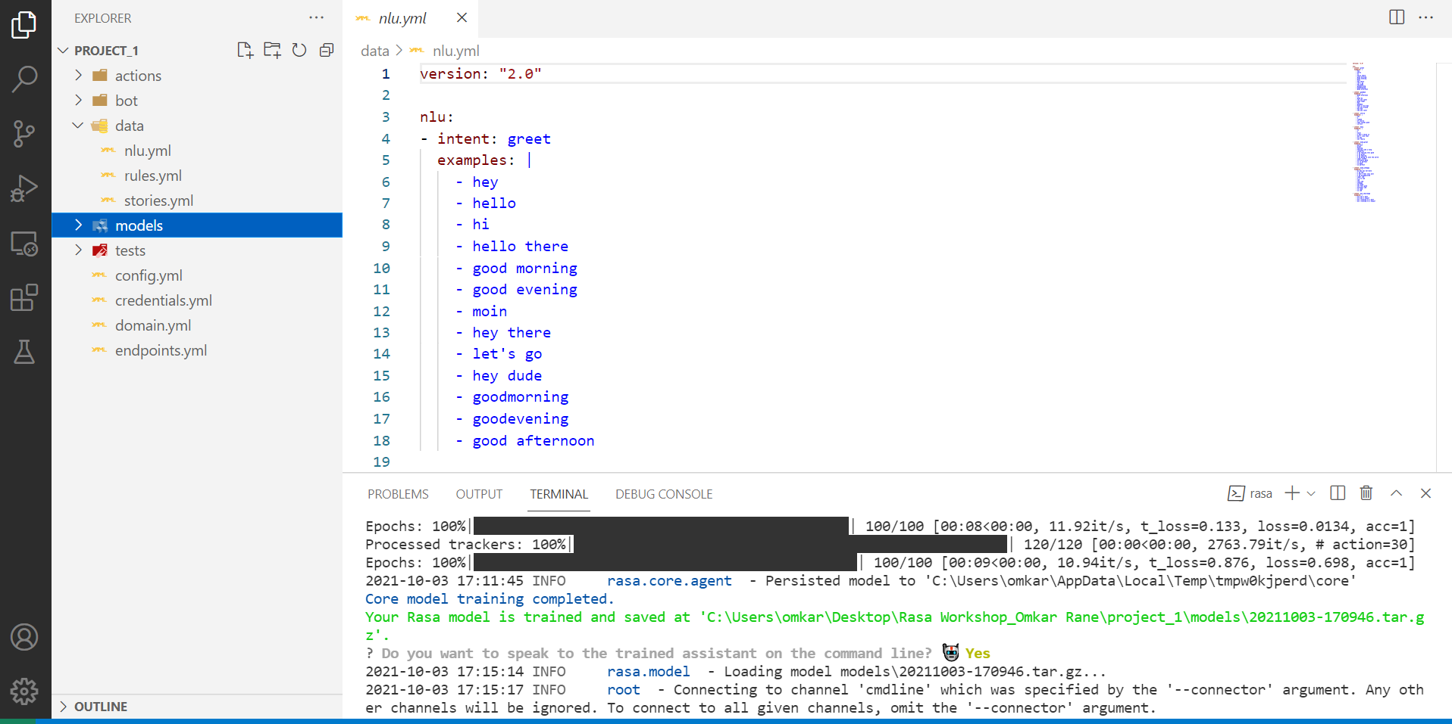
NLU training data
Ref:
https://rasa.com/docs/rasa/training-data-format/
https://rasa.com/docs/rasa/nlu-training-data

Slide 15
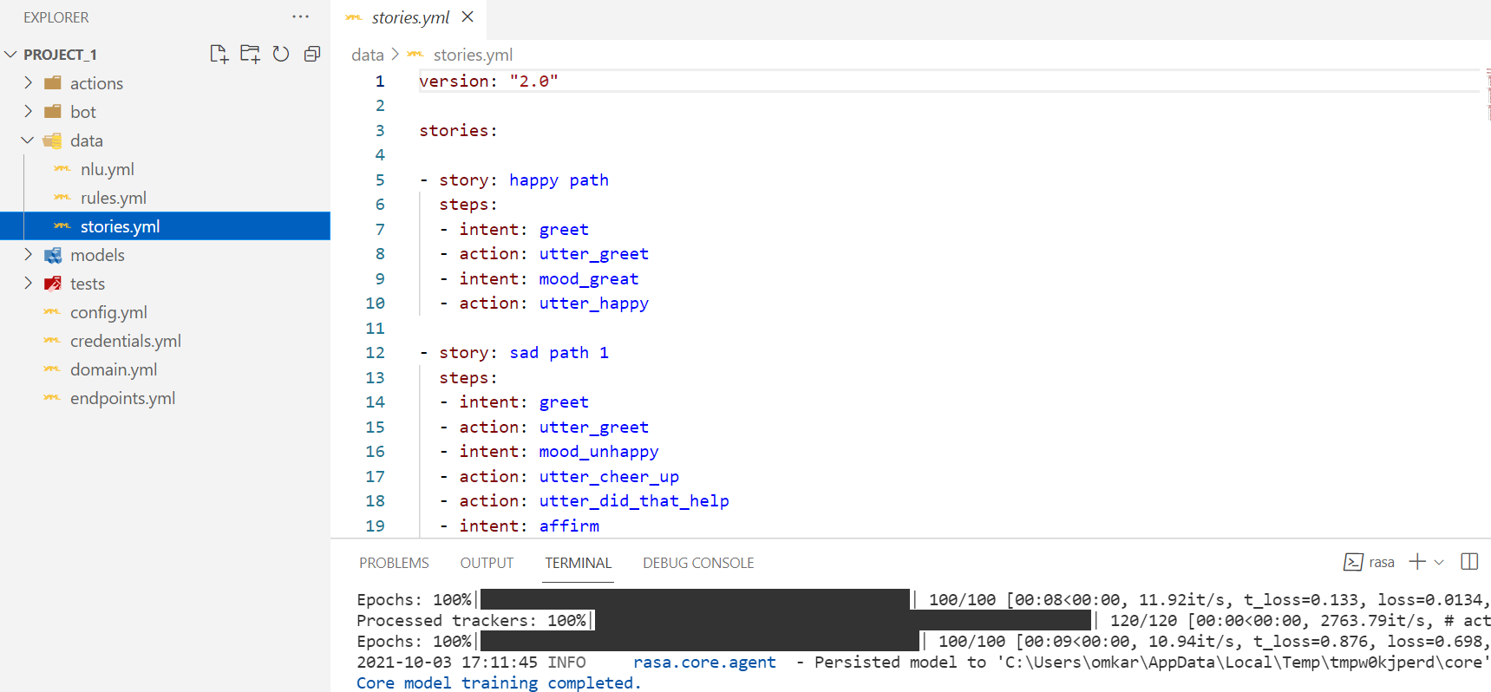
Dialog Model/Stories training data
Ref: https://rasa.com/docs/rasa/stories

Slide 16
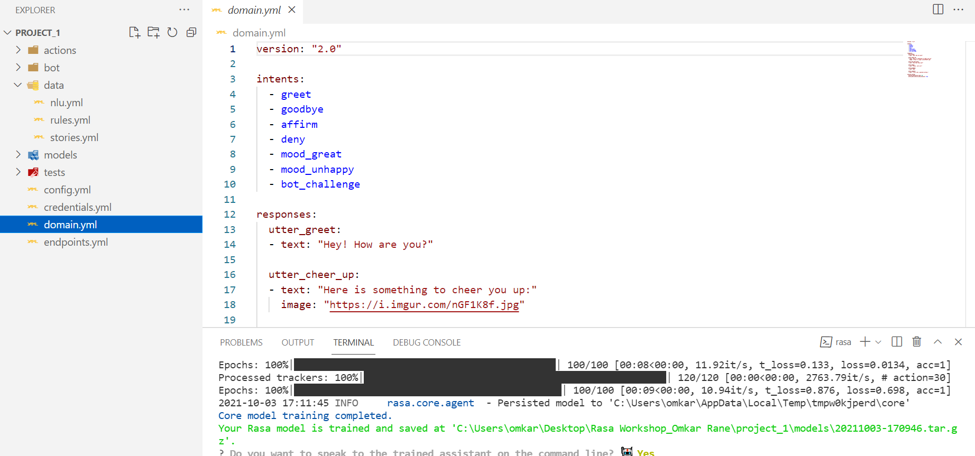
Domain training data
Ref: https://rasa.com/docs/rasa/domain

Slide 17
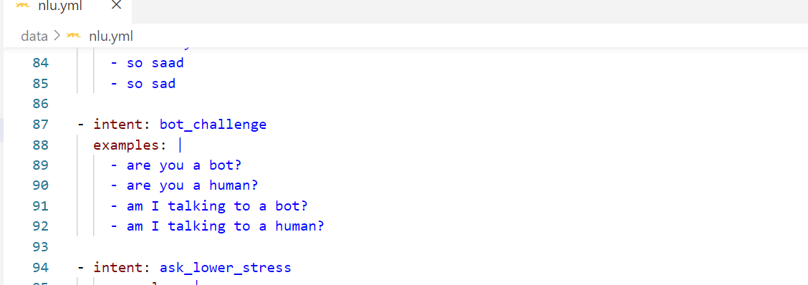
Adding NLU training data

Slide 18
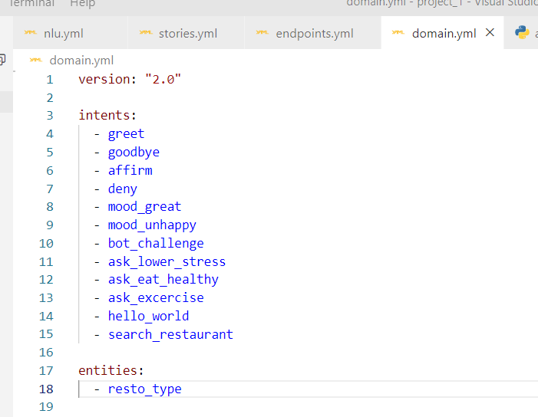
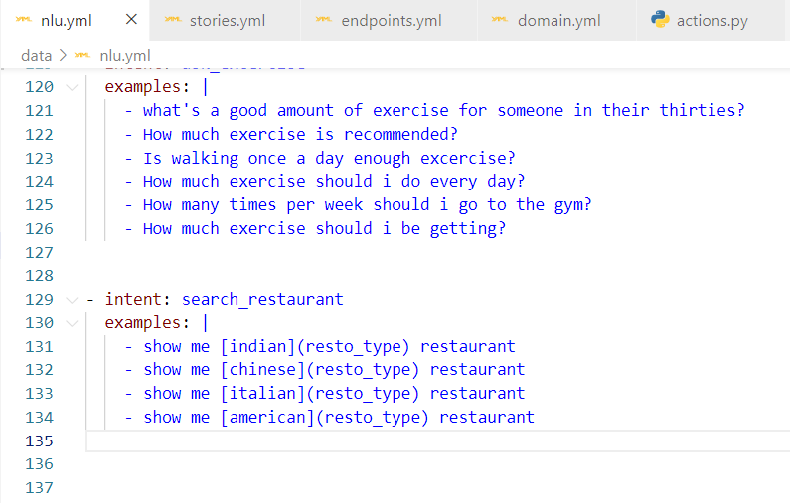
Adding Entity
Add entity and type entities in nlu.yml
Add entities in domain.yml
Ref: https://rasa.com/docs/action-server/sdk-tracker

Slide 19
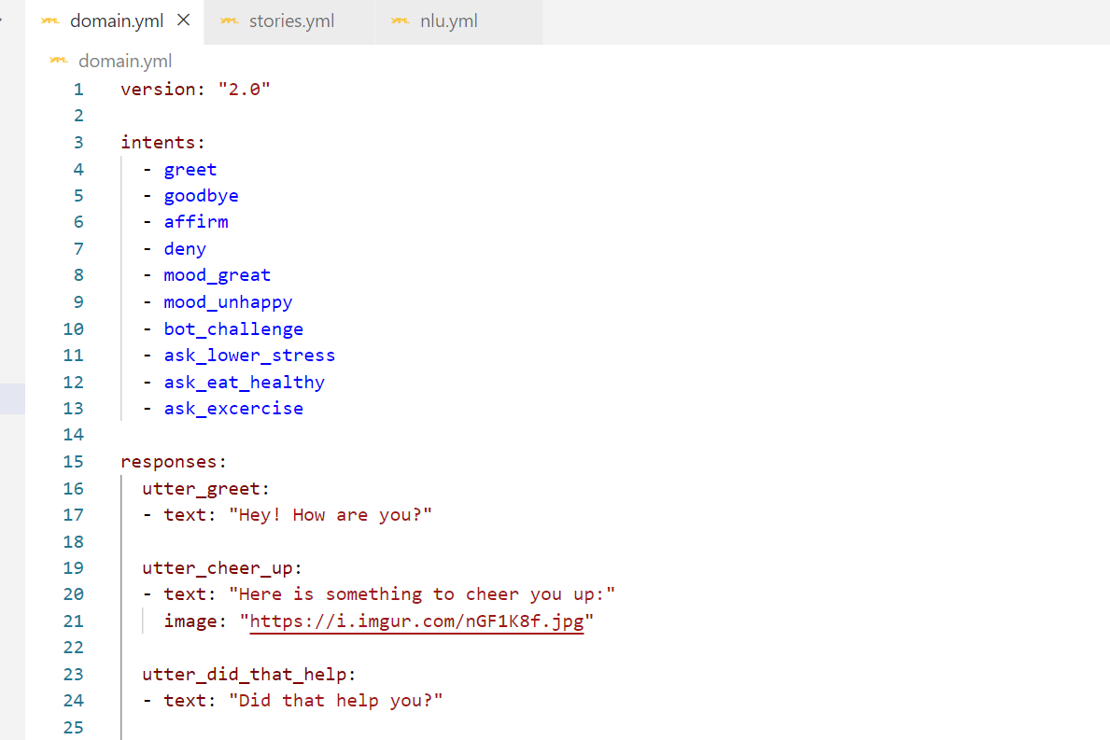
Adding Domain training data

Slide 20
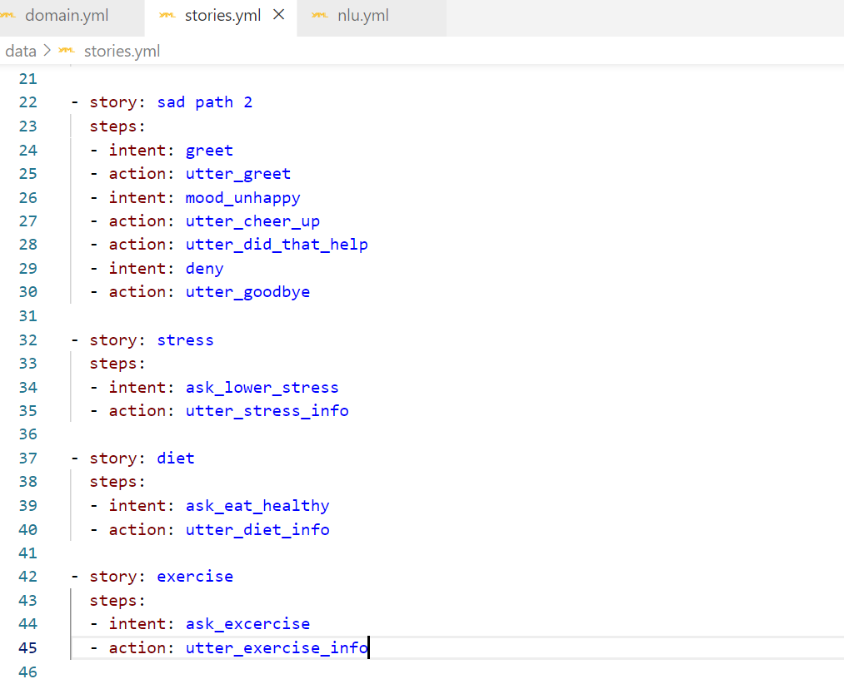
Adding Stories

Slide 21
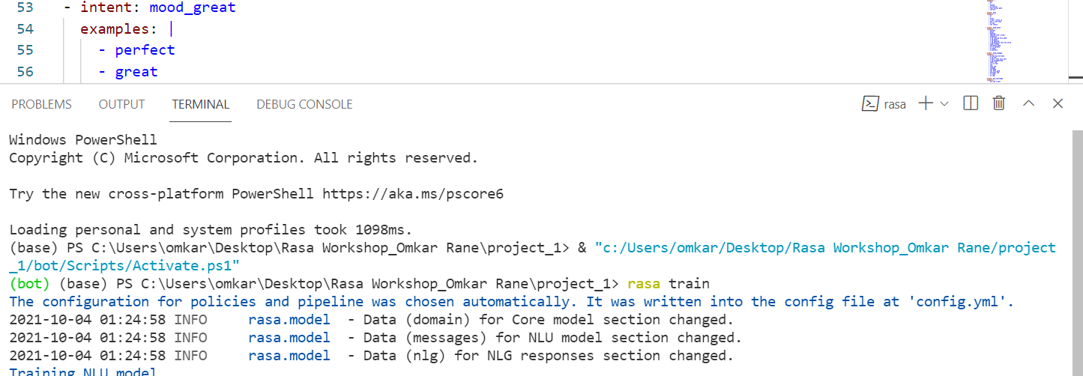
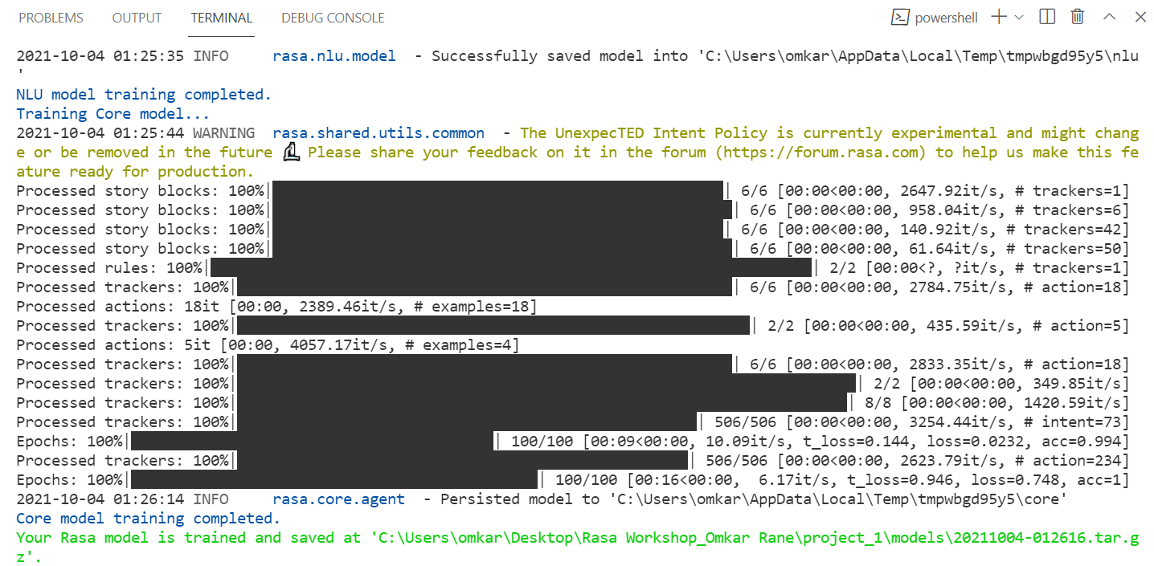
Training Rasa Model
use ‘rasa train’ command in terminal.

Slide 22
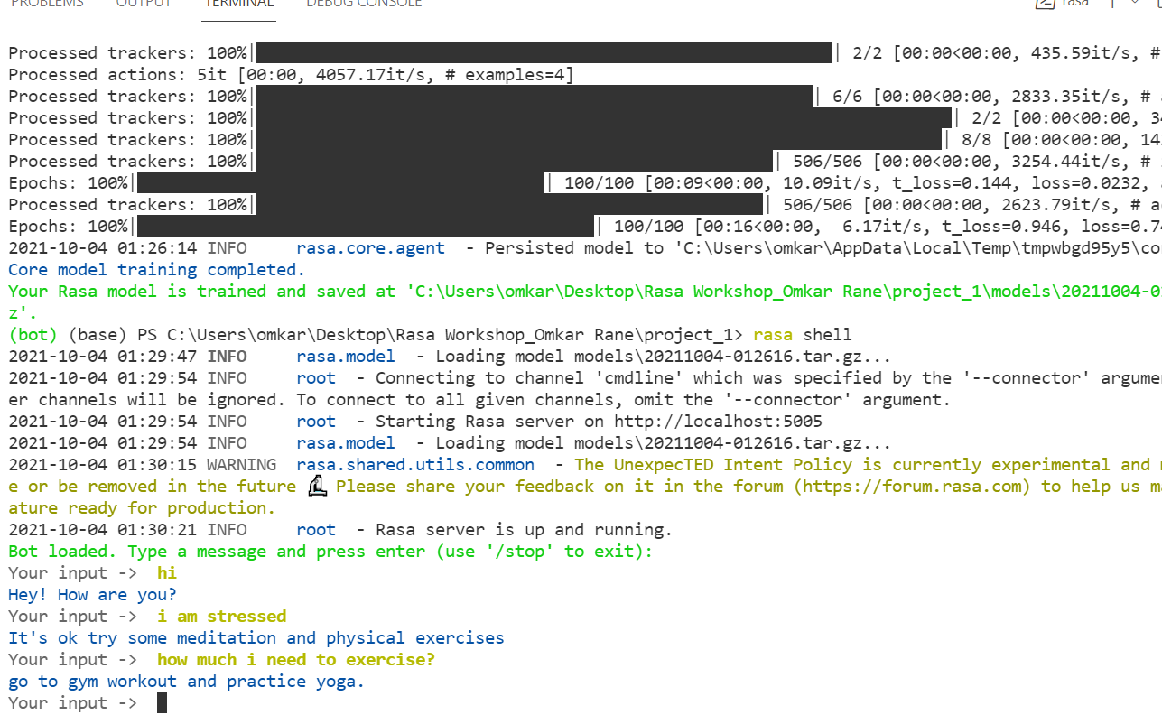
Testing training data
Use command ‘rasa shell’ in terminal

Slide 23
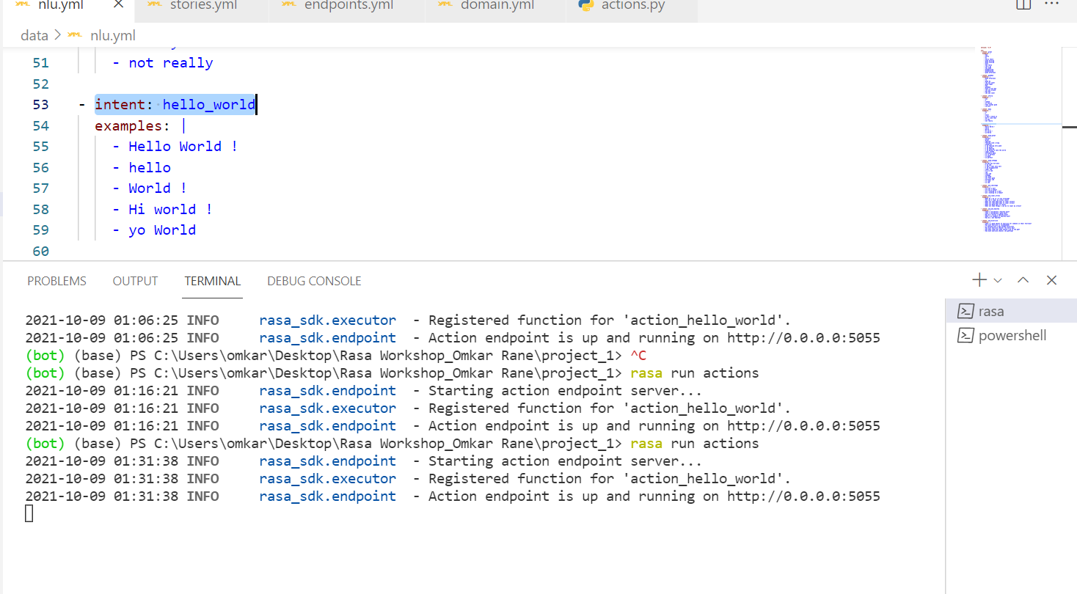
Custom Action Implementation
Adding of intents in nlu file

Slide 24
Tracker Class
The Tracker class represents a Rasa conversation tracker. It lets you access your bot's memory in your custom actions. You can get information about past events and the current state of the conversation through Tracker attributes and methods.
Attributes#
The following are available as attributes of a Tracker object:
sender_id - The unique ID of person talking to the bot.
slots - The list of slots that can be filled as defined in the “ref”domains.
latest_message - A dictionary containing the attributes of the latest message: intent, entities and text.
events - A list of all previous events.
active_loop - The name of the currently active loop.
latest_action_name - The name of the last action the bot executed.
Ref: https://rasa.com/docs/action-server/sdk-tracker

Slide 25
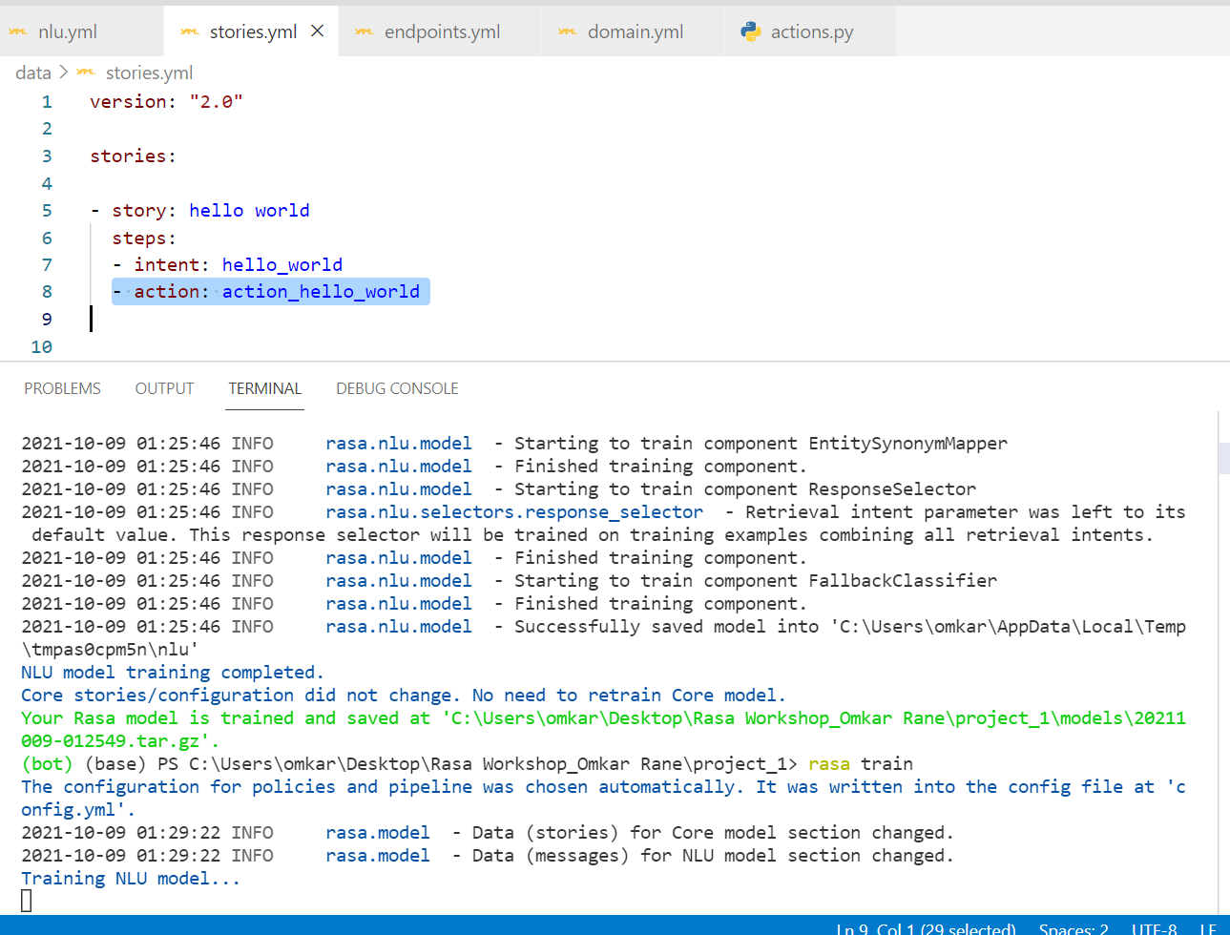
* Refer to action_hello_world here writing action keyword is important

Slide 26
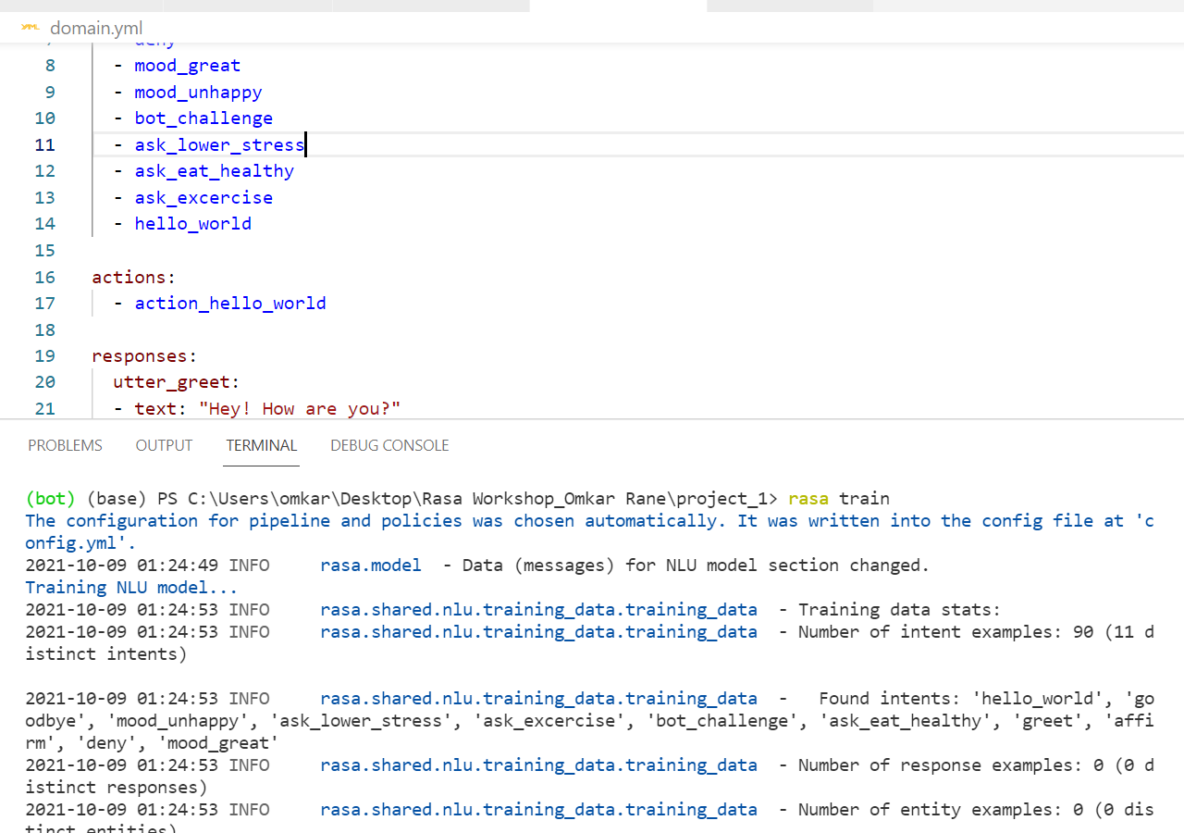
*defining Actions in domain file

Slide 27
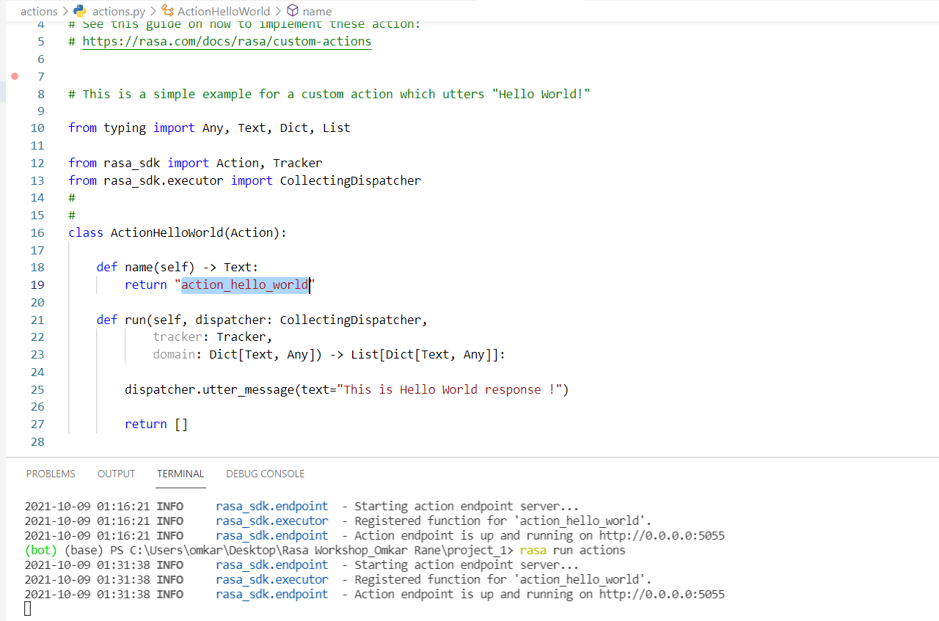
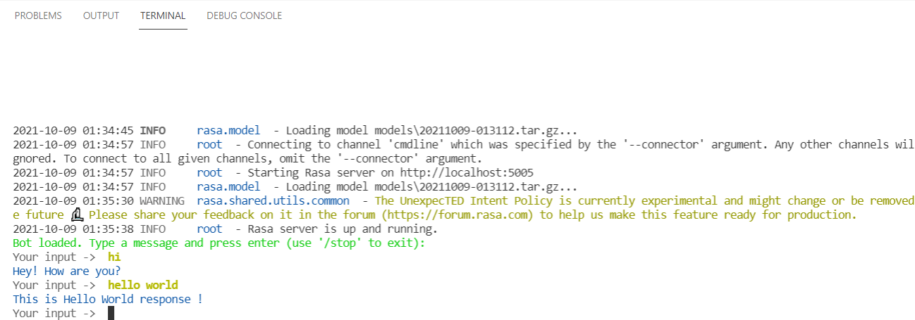
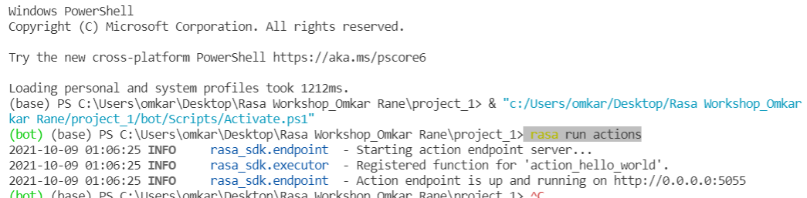
Step1) retrain model with ‘rasa train’
Step 2) register action with ‘rasa run actions’ in separate shell.
Step 3) test bot with ‘rasa shell’ command
Ref: https://rasa.com/docs/action-server/sdk-tracker
Remove Comment from existing code and modify code in actions.py file

Slide 28
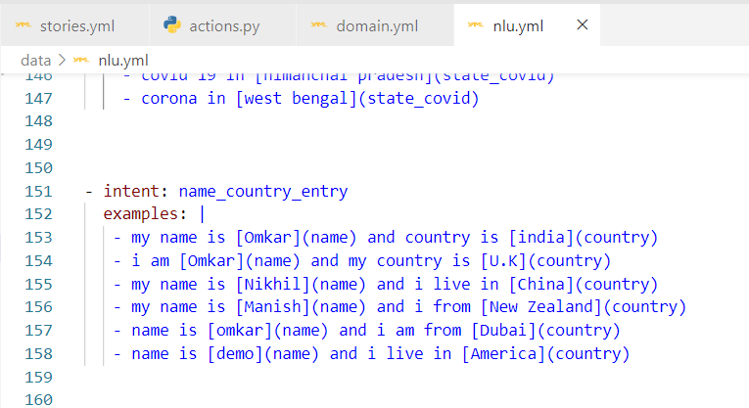
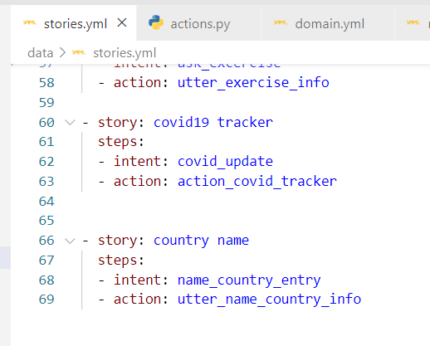
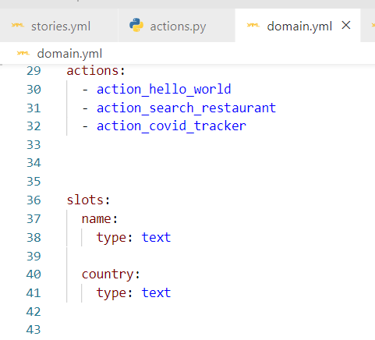
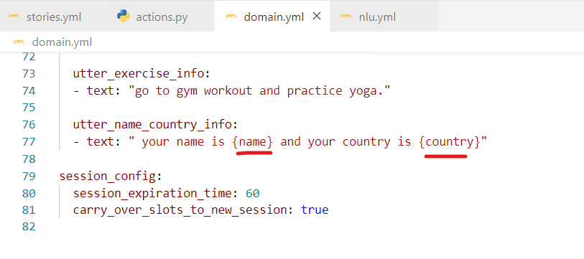
(Bot Memory) Slot set by NLU
Entity name should be same as slot name
Run ‘rasa run actions’ server command
Ref: https://rasa.com/docs/rasa/domain/

Slide 29
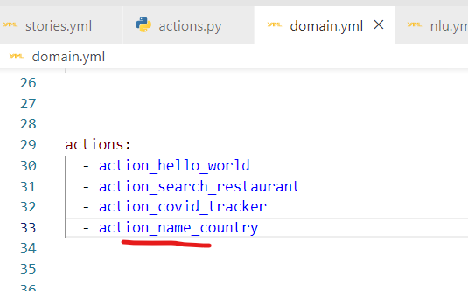
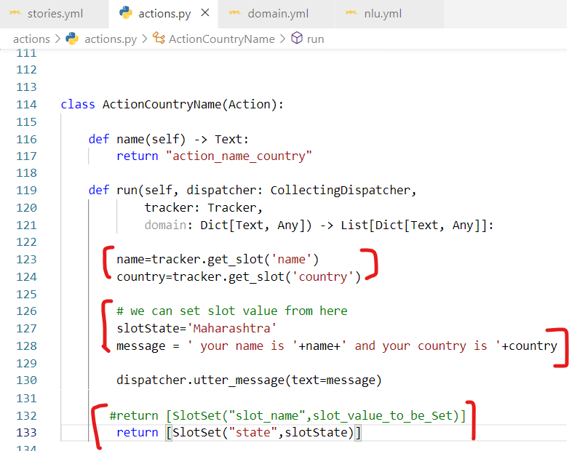
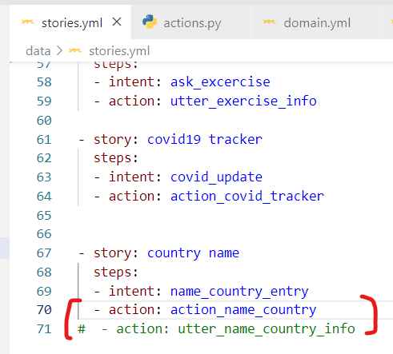
(Bot Memory) Slot set by Action
NLU training remains same as previous
Run ‘rasa run actions’ server command
# single line comment and import below
from rasa_sdk.events import SlotSet
We can set slot from both NLU and by action simultaneously

